Slide 1
Functional Form-Lags
ECON 6010 Statistical Methods
Dr. Fadi Fawaz
Department of Economics and Finance
Tennessee State University©

Slide 2
Introduction
Discuss the importance of functional form
Examine the Ramsey Reset Test for Functional Form
Describe the use of lags in econometric models
Evaluate the Koyk transformation as a means of overcoming some of the problems of lagged variables

Slide 3
Functional Form
A further assumption we make about the econometric model is that it has the correct functional form.
This requires the most appropriate variables in the model and that they are in the most suitable format, i.e. logarithms etc.
One of the most important considerations with financial data is that we need to model the dynamics appropriately, with the most appropriate lag structure.

Slide 4
Functional Form
It is important we include all the relevant variables in the model, if we exclude an important explanatory variable, the regression has ‘omitted variable bias’. This means the estimates are unreliable and the t and F statistics can not be relied on.
Equally there can be a problem if we include variables that are not relevant, as this can reduce the efficiency of the regression, however this is not as serious as the omitted variable bias.
The Ramsey Reset test can be used to determine if the functional form of a model is acceptable.

Slide 5
Lagged Variables
A possible source of any problem with the functional form is the lack of a lagged structure in the model.
One way of overcoming autocorrelation is to add a lagged dependent variable to the model.
However although lagged variables can produce a better functional form, we need theoretical reasons for including them.

Slide 6
Inclusion of Lagged variables
Inertia of the dependent variable, whereby a change in an explanatory variable does not immediately effect the dependent variable.
The overreaction to ‘news’, particularly common in asset markets and often referred to as ‘overshooting’, where the asset ‘overshoots’ its long-run equilibrium position, before moving back towards equilibrium
To allow the model to produce dynamic forecasts.

Slide 7
Types of Lag
Autoregressive refers to lags in the dependent variable
Distributed lag refers to lags of the explanatory variables
Moving average refers to lags in the error term.

Slide 8
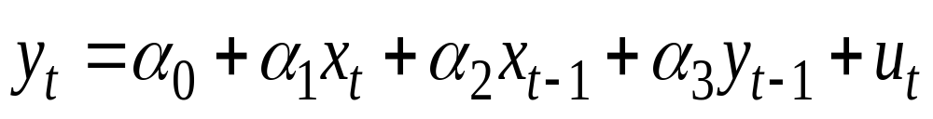
ARDL Models
An Autoregressive Distributed lag model or ARDL model refers to a model with lags of both the dependent and explanatory variables. An ARDL(1,1) model would have 1 lag on both variables:

Slide 9
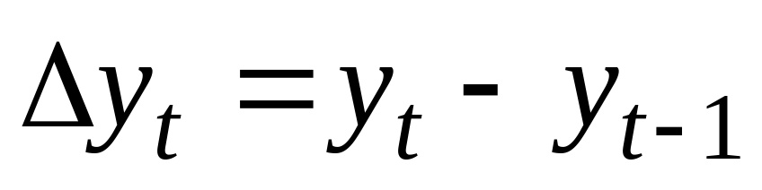
Differenced Variables
A differenced or ‘change’ variable is used to model the change in a variable from one time period to the next. This type of variable is often used with lagged variables to model the short run.

Slide 10
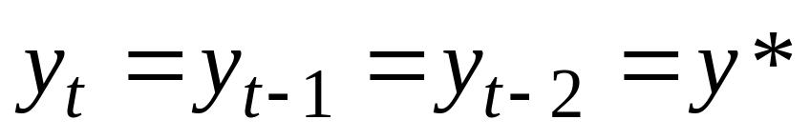
The long-run static equilibrium
In econometrics the long and short run are modelled differently. (later we will use cointegration to model this).
The long-run equilibrium is defined as when the variables have attained some steady-state values and are no longer changing.
In the long-run we can ignore the lags as:

Slide 11
Long-Run
To obtain the long-run steady-state solution from any given model we need to:
- Remove all time subscripts, including lags
- Set the error term equal to its expected value of 0.
- Remove the differenced terms
- Arrange the equation so that all x and y terms are on the same side.

Slide 12
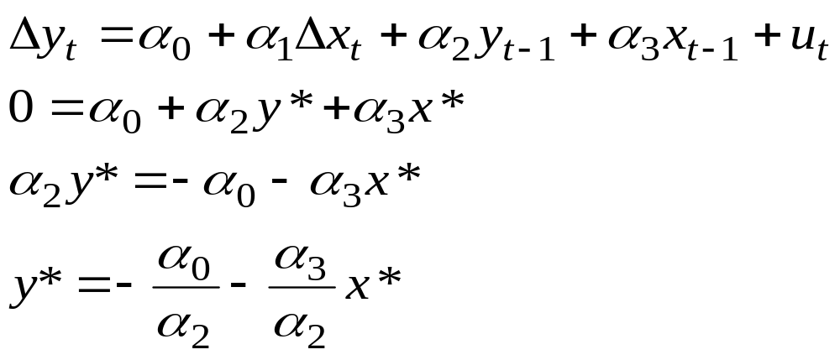
Long-run
For example given the following model, we can use the previous rules to form a long-run steady-state solution:

Slide 13
Potential Problems with Lagged Variables
The main problem is deciding how many lags to include in a model.
The use of lagged dependent variables can produce some econometric problems.
With a number of lags, there can be problems of multicollinearity between the lags
There can be difficulties with interpreting the coefficients on the lags and offering a theoretical reason for their inclusion

Slide 14
Conclusion
It is important to ensure the functional form of the econometric model is correct.
This may require the inclusion of lags.
The use of lags and differenced variables allows the examination of the short-run dynamic properties of the model.

